Slide 1
Climate, air pollution, and policy
Macro, micro, theory, and empirics
Ivan Rudik

Slide 2
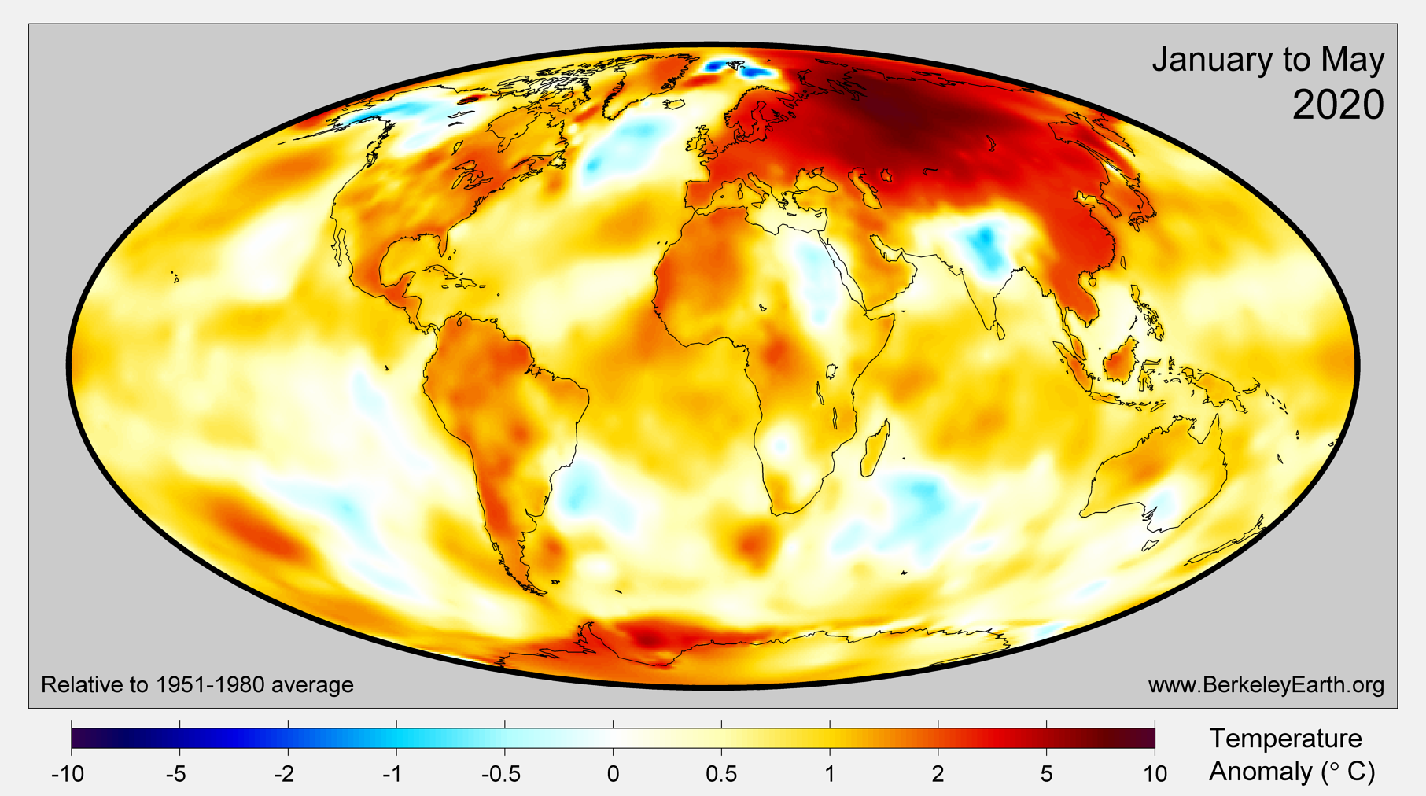

Slide 3
Climate change
How should economists think about climate change?
The importance of uncertainty (Lemoine and Rudik 2016)
Proper climate modules (Lemoine and Rudik 2017)
Endogenous damage learning / robustness (Rudik 2020)
Identifying the correct climate estimand (Rudik et al. 2021)
Reduced form IAM + decomposition (Moore et al. 202X)
Networks and distortions (Lemoine, Rudik, and Tan 202X)

Slide 4
How do we identify effects of changes in climate using observable data?
Does temperature variation identify marginal climate effects?
Two farmer thought experiments:
Iowa farmer growing corn/soy
California farmer growing almonds
Why might an increase in transient/idiosyncratic temperature today be different than an increase in climate?

Slide 5
How do we identify effects of changes in climate using observable data?
Iowa farmer growing corn/soy can switch to rice/cotton in the long run
2) California farmer growing almonds can pull on depletable groundwater resources in the short run
Impacts of temperature on profits, yields, etc will overstate climate impacts in Iowa, understate impacts in California

Slide 6
How do we identify effects of changes in climate using observable data?
Circumvent these issues with envelope theorem arguments
Weather variation = climate variation for optimized payoffs
Main challenge: most realistic representations of payoffs are not observable or do not respond to transient temperature
Utility, PV utility streams, PV profits, land prices, etc

Slide 7
How do we identify effects of changes in climate using observable data?
Rudik, Lyn, Tan, Ortiz-Bobea (2021) provides a roadmap
Under some light assumptions about household behavior we can show in-migration shares are a sufficient statistic for expected welfare

Slide 8
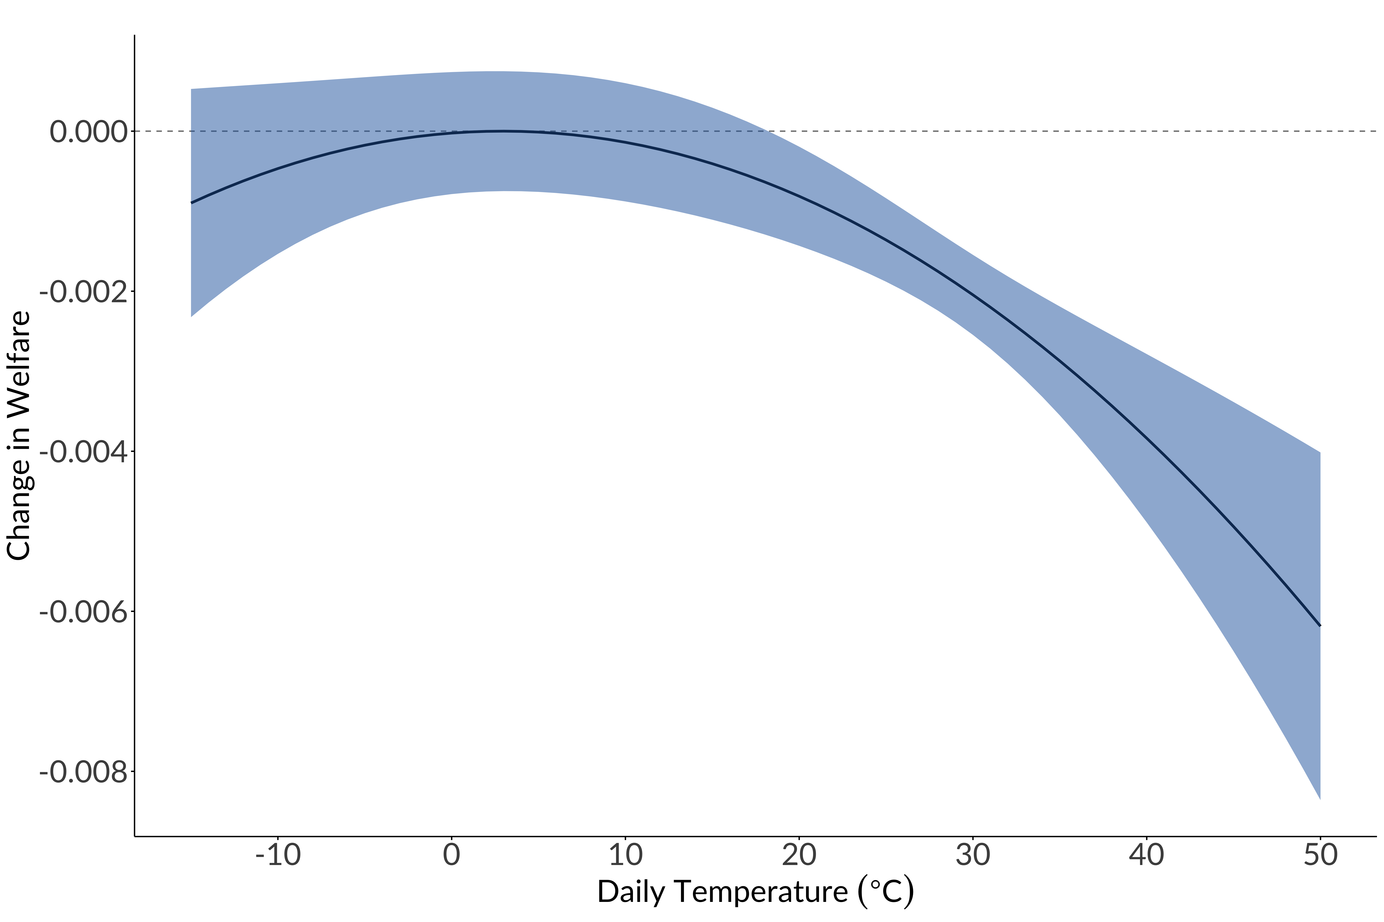
Extreme hot days are
extremely bad for welfare

Slide 9
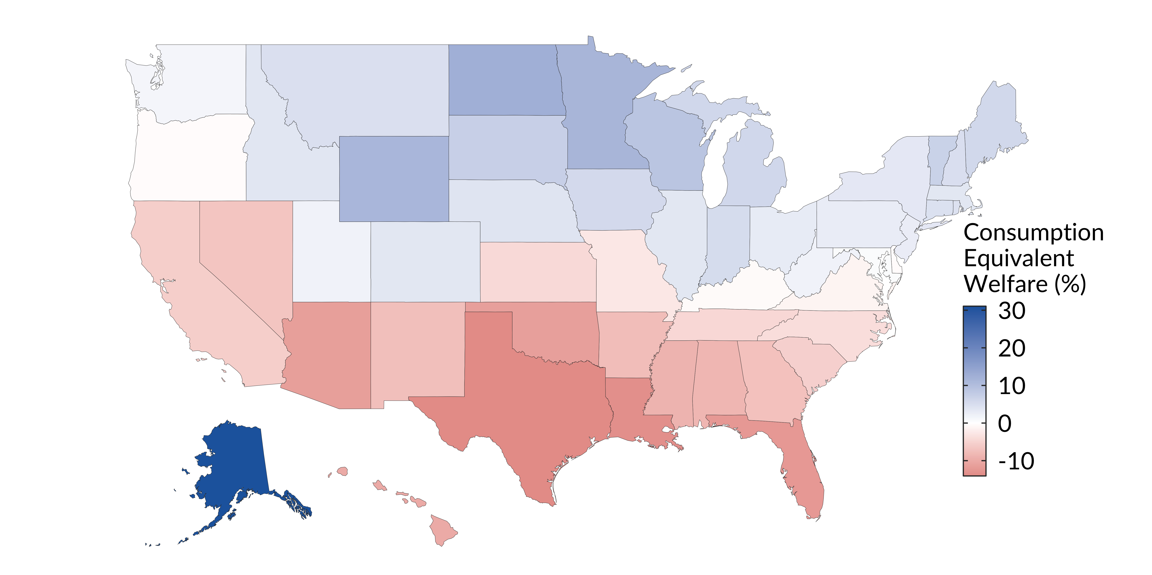
Extreme hot days are
extremely bad for welfare

Slide 10
Beyond welfare
To go beyond welfare we need structure
Build a quantitative dynamic spatial model to get the rest:
Migration
Employment
Value of adaptation through market mechanisms

Slide 11
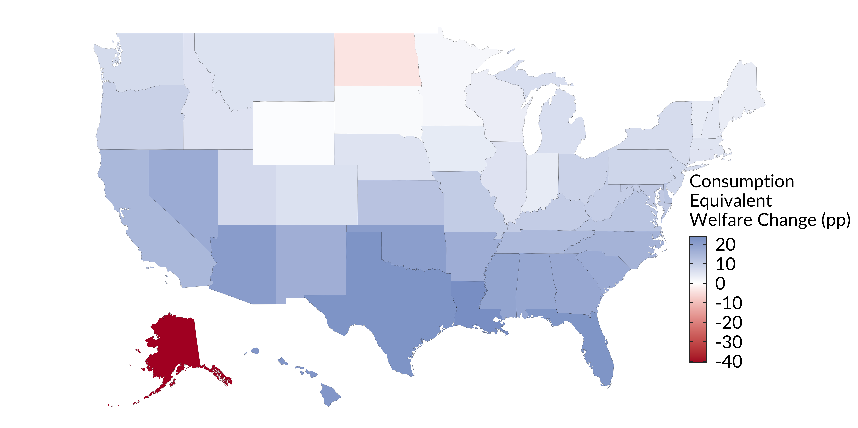
The value of market-based adaptation

Slide 12
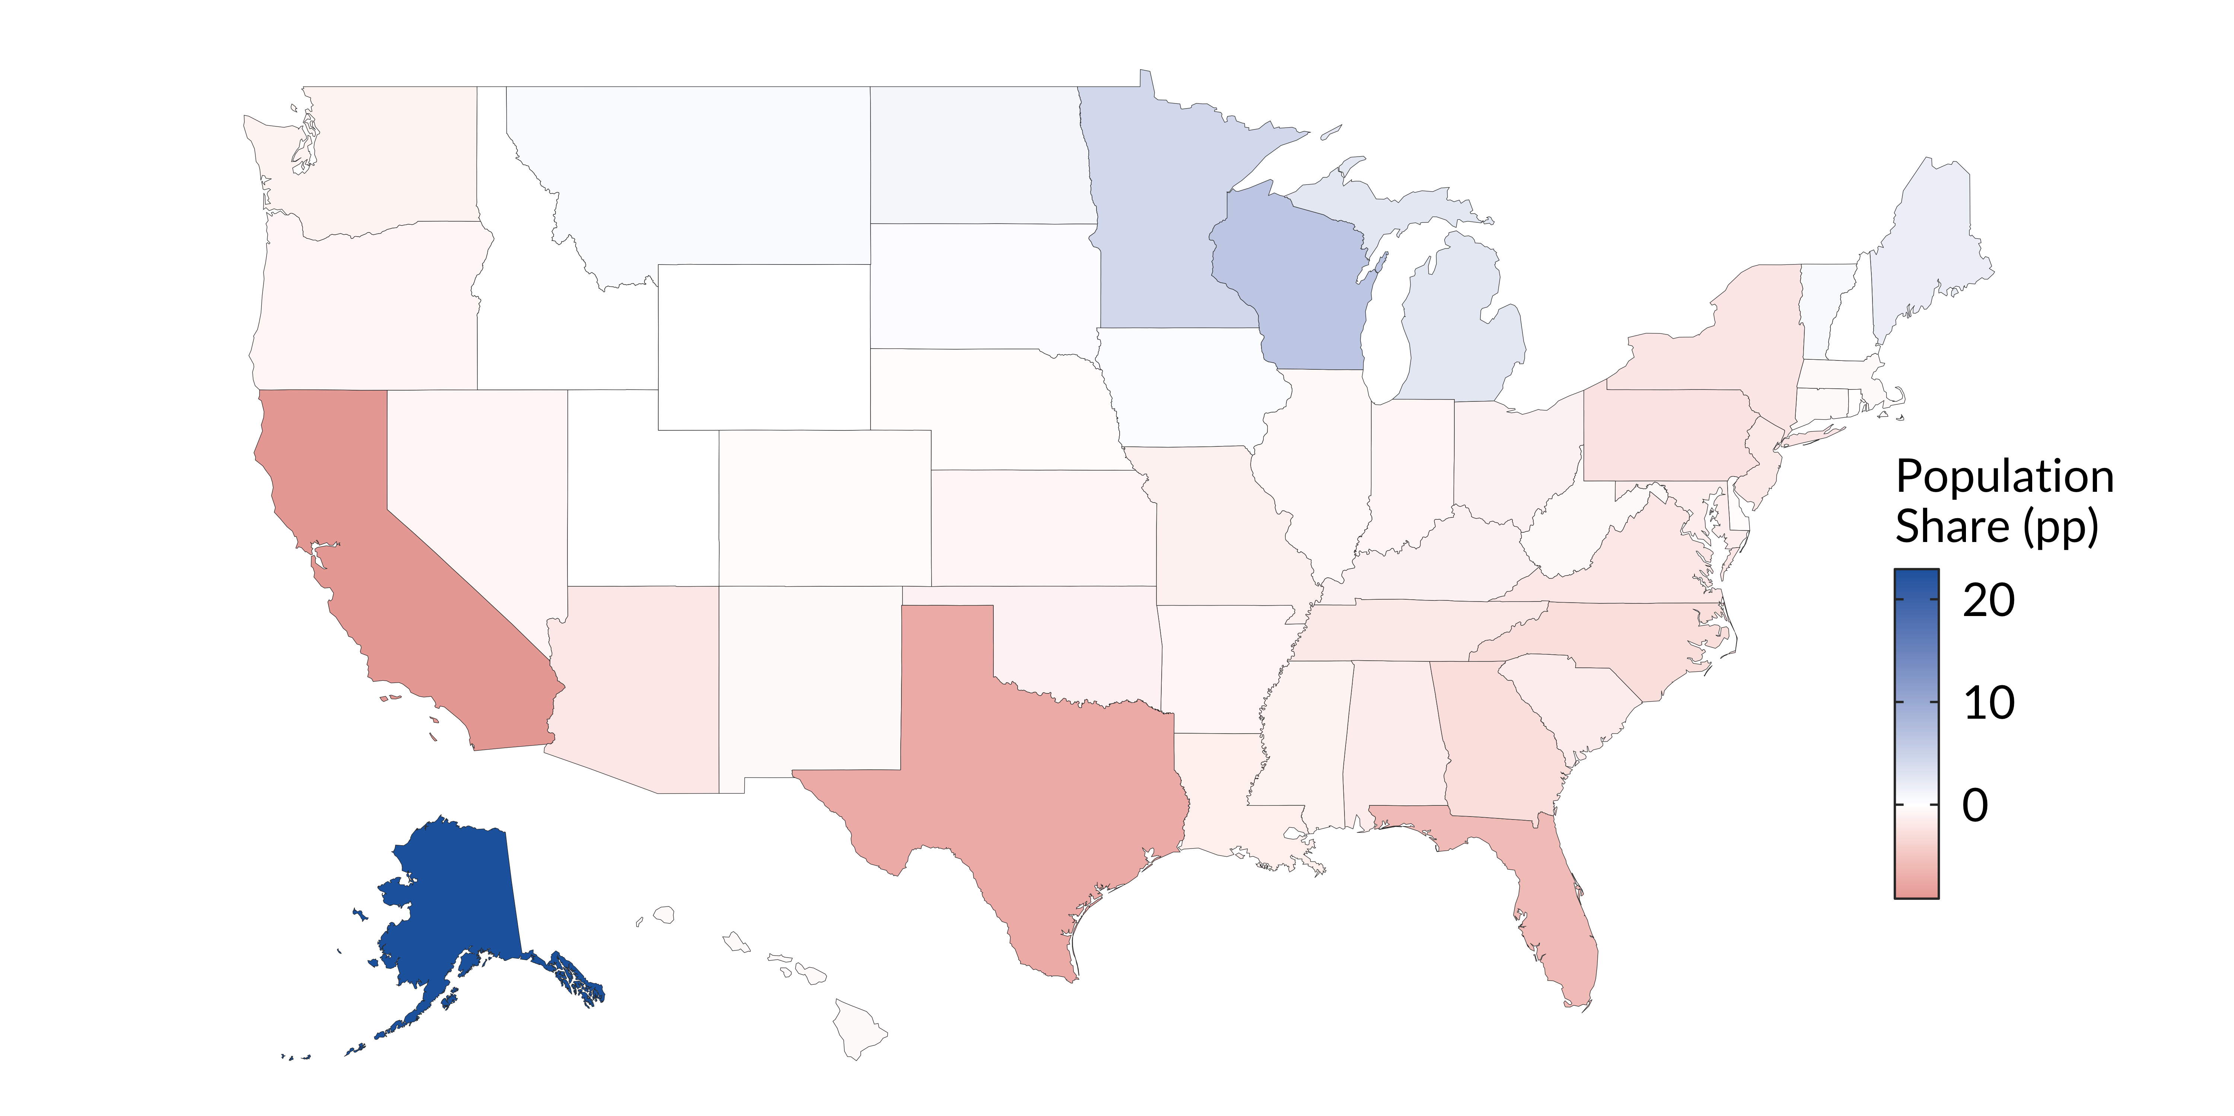
Climate migration

Slide 13
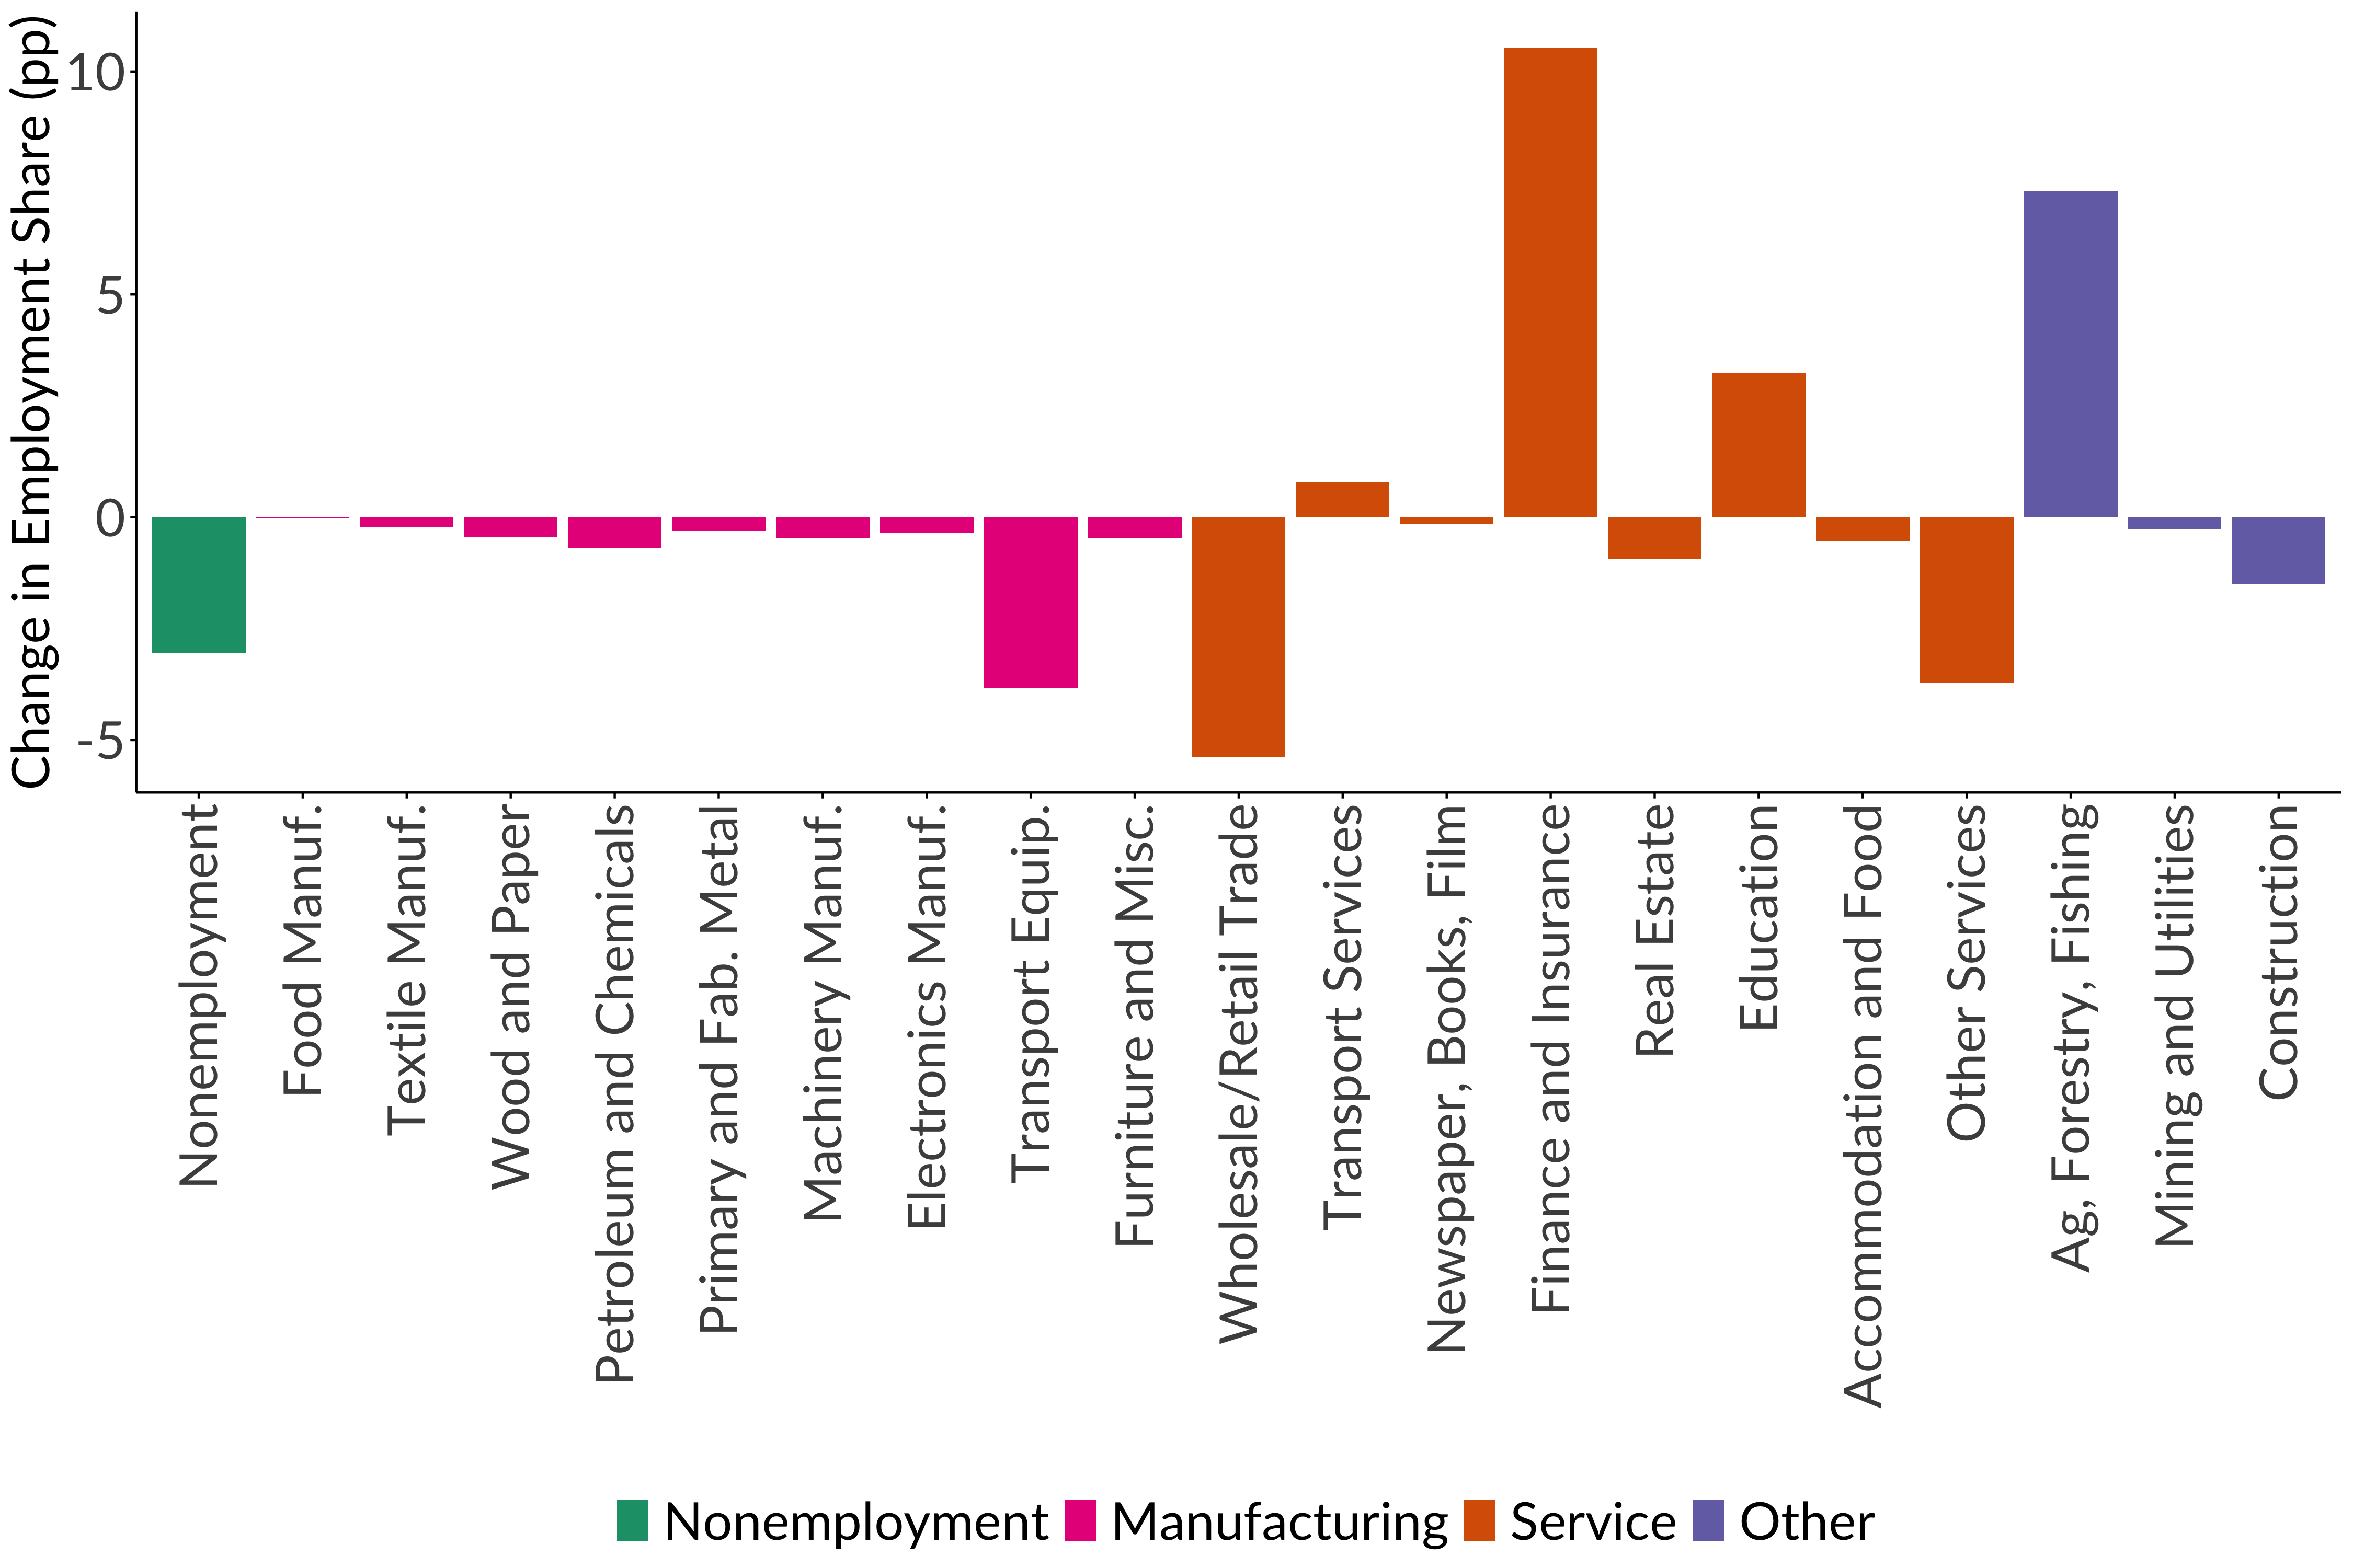
Industrial reallocation

Slide 14
The role of uncertainty in carbon pricing
Lemoine and Rudik (2016) show the role
of uncertainty in carbon taxes
Rudik (2020) asks what is the
effect on optimal climate policy if we:
Account for how economists will update future damages
Account for how we know our economic models are misspecified

Slide 15
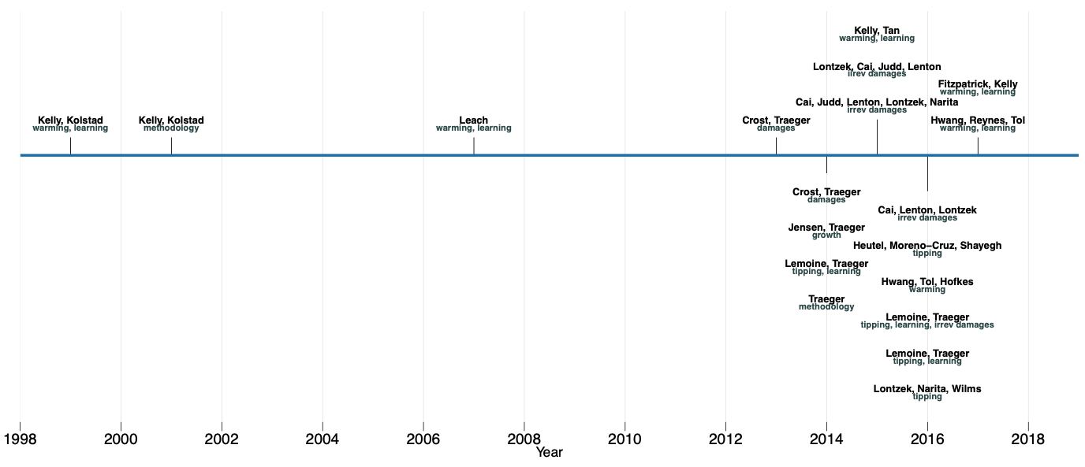
Uncertainty in carbon pricing
is a new literature

Slide 16
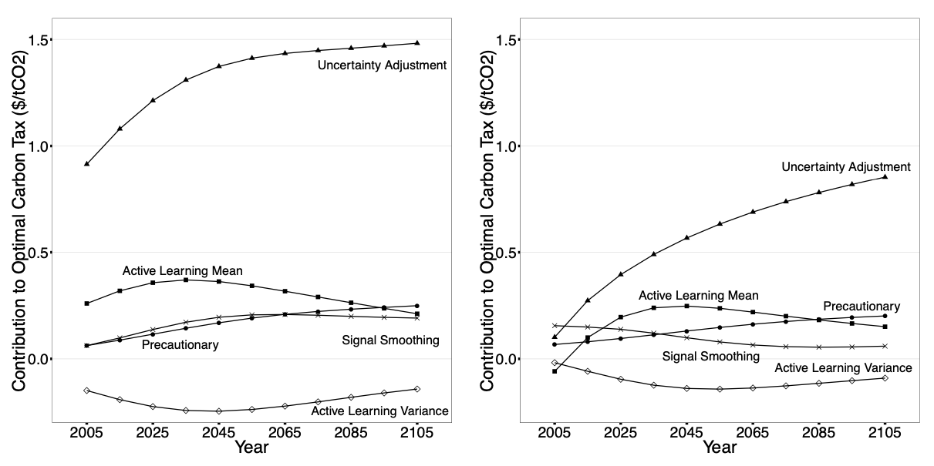
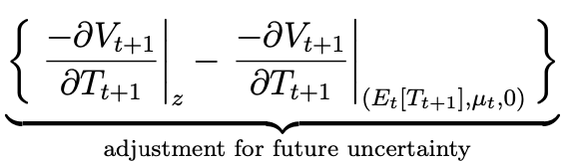
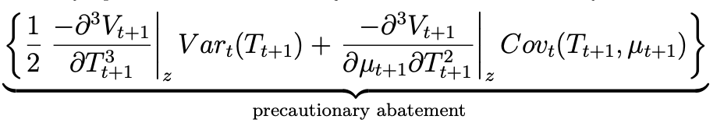
You can decompose taxes into standard consumption-saving channels

Slide 17
The role of uncertainty in carbon pricing
Damage uncertainty matters (Lemoine and McJeon 2013)
Economists update estimates of marginal damages (e.g. Climate Impact Lab)
Economists know economists update estimates

Slide 18
The role of uncertainty in carbon pricing
We know these estimates and models are wrong (Pindyck 2013)
E.g. Dietz and Stern (2015) damage function is widely used but they are very clear that it’s completely made up
We should design policy to guard against model misspecifications

Slide 19
Policy under different states of the world

Slide 20
Consumption-saving decompositions

Slide 21
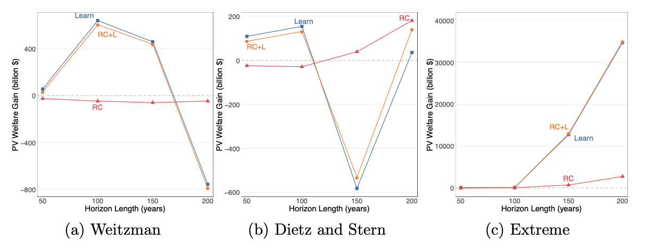
Learning helps (usually)
even if models are very wrong

Slide 22
What matters for the social cost of carbon?
Meta-analysis / reduced form SCC
Moore, Rising, Dietz, Drupp, Rudik, Wagner (202X)
There’s lots of integrated assessment papers making structural changes or introducing uncertainty
They all give different results for the price of carbon
What are the key drivers?

Slide 23
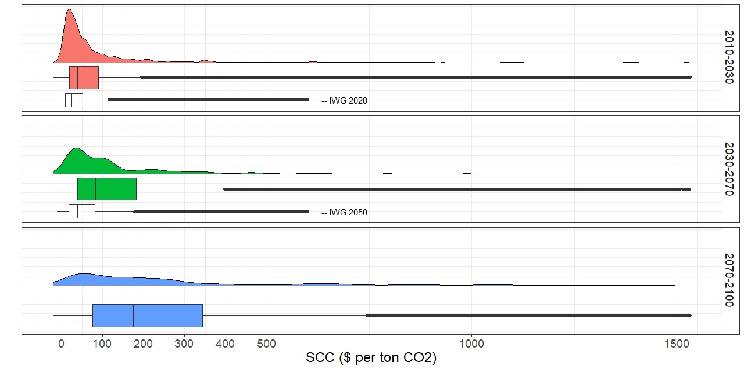
The SCC from the literature since 2000

Slide 24
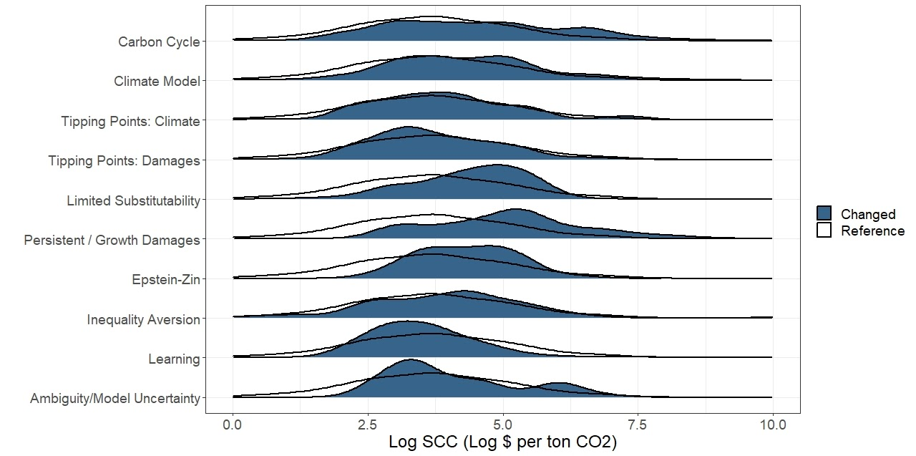
The relative effects of
different structural changes

Slide 25
What matters for the social cost of carbon?
Meta-analysis / reduced form SCC
Moore, Rising, Dietz, Drupp, Rudik, Wagner (202X)
Next steps: train random forest model to get a reduced form predictor of SCC as a function of standard inputs (year, discount rate, model structure Booleans)
Why: allows researchers to recover a literature-consistent SCC estimate without having to run these complicated structural models

Slide 26
Optimal science funding
Hurricane forecasts have improved significantly over time
Molina and Rudik (2021)
What is the historical value of this?
How much should we fund future research for improving forecasts?

Slide 27
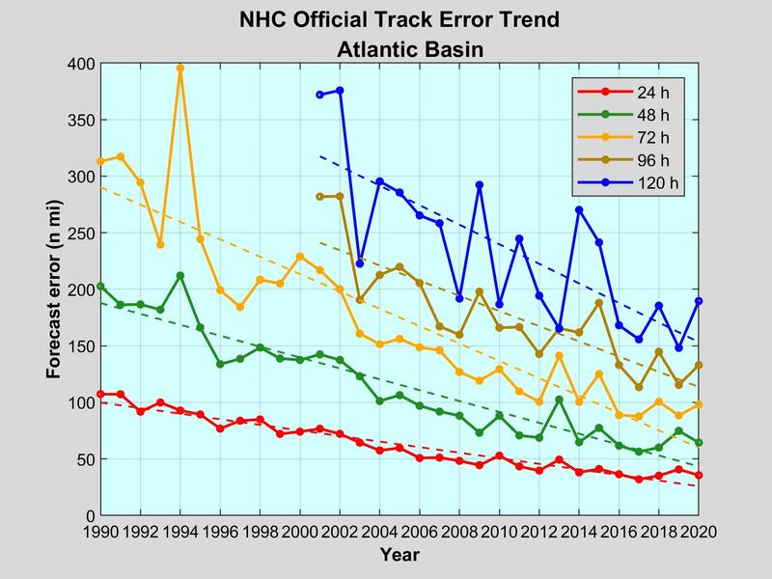
NOAA NHC

Slide 28
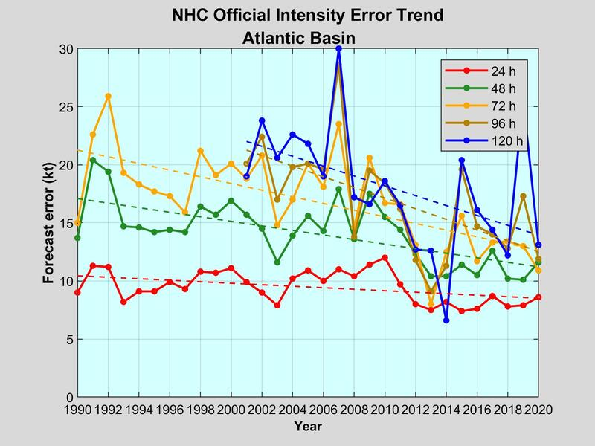
NOAA NHC

Slide 29
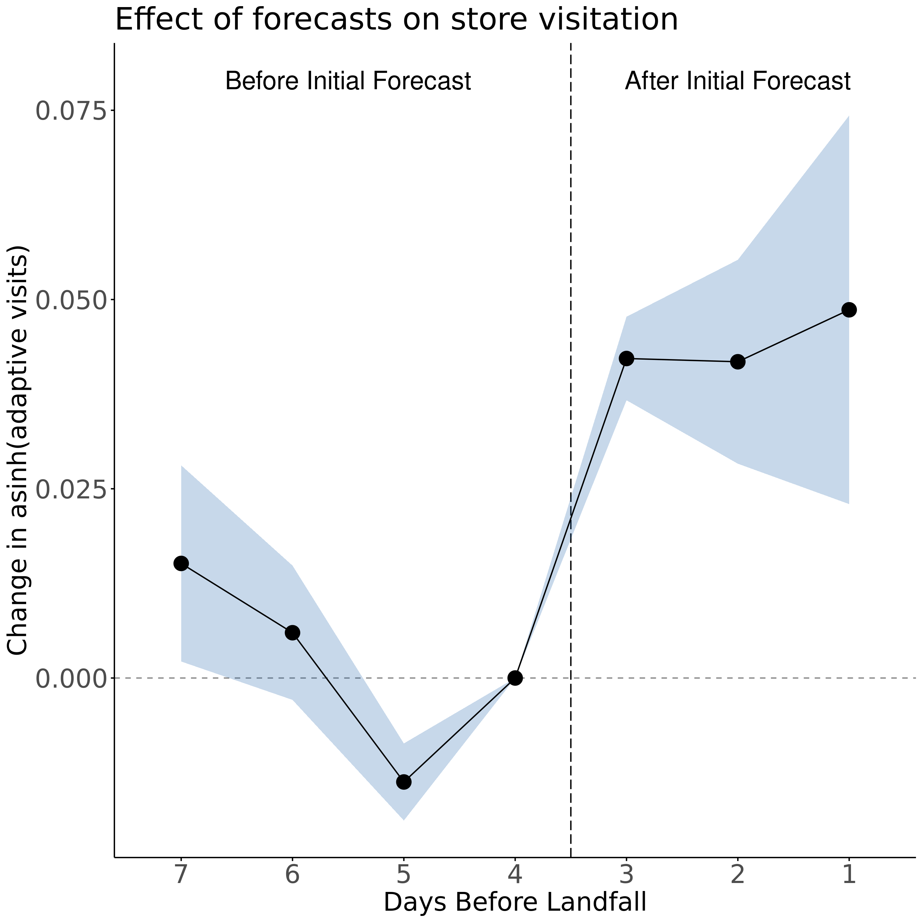
Do forecasts matter
for household
decisions?
An above historical-median forecast increases store visitation in days before storm

Slide 30
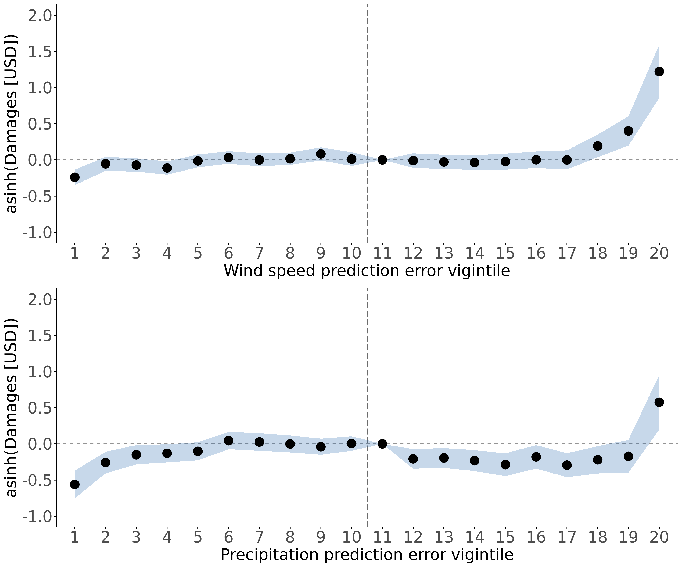
Do forecast errors matter?
Overestimate
intensity
Underestimate
intensity
Underestimating hurricane intensity, wind or precipitation, leads to significantly greater damage

Slide 31
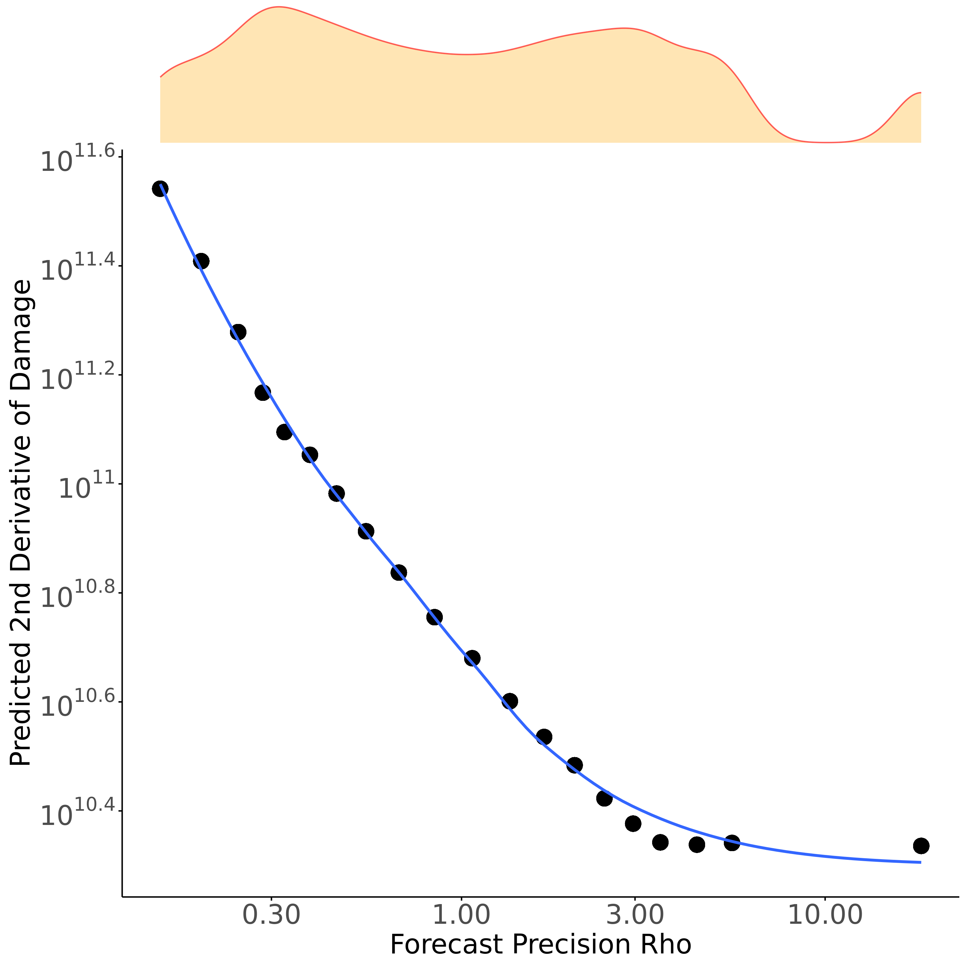
The MWTP for better forecasts
Simple household cost minimization problem:
Regress second derivative of damages on precision
Coefficient is the marginal value of reducing forecast uncertainty

Slide 32
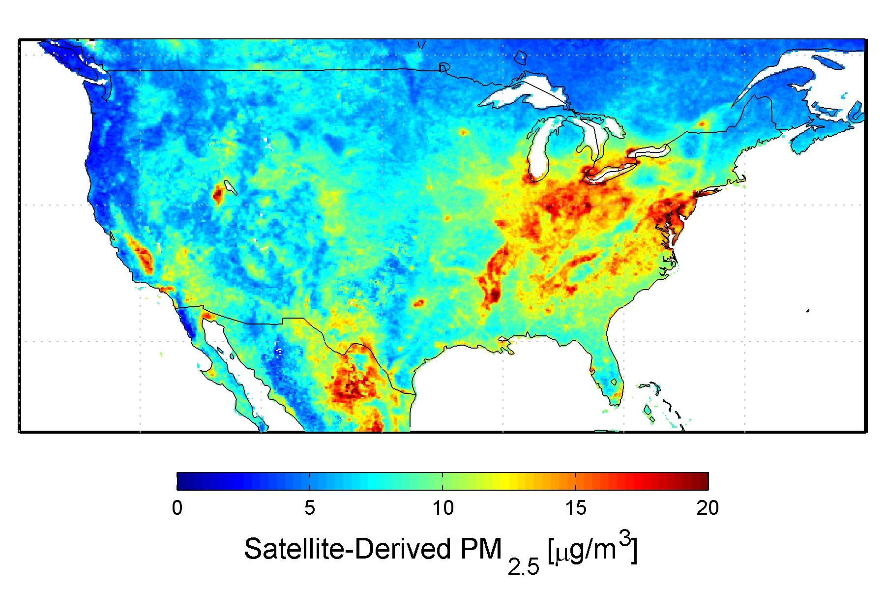

Slide 33
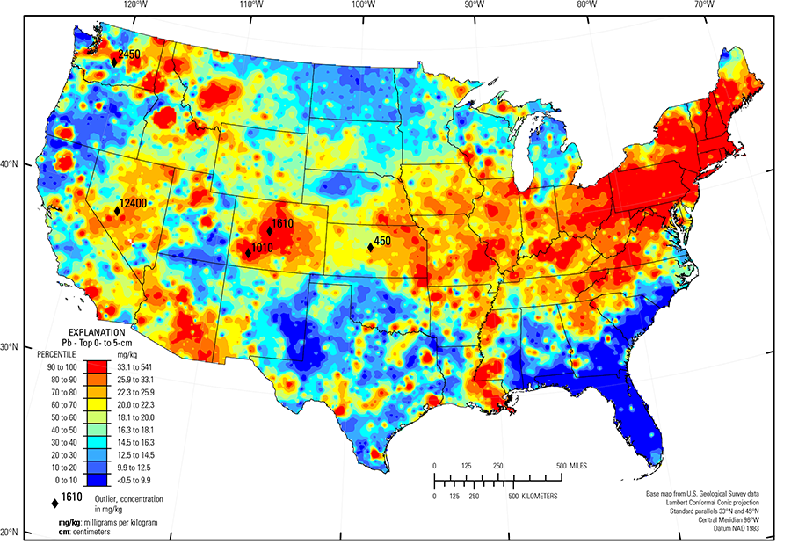

Slide 34
Air pollution
What is the social cost of lead?
Lead is bad for
Mortality (Hollingsworth and Rudik, 2021)
Kids (Hollingsworth et al. 2021)
But nutrition can help (Hollingsworth et al. 2021)

Slide 35
We use racing to generate
quasi-experimental variation in lead emissions

Slide 36
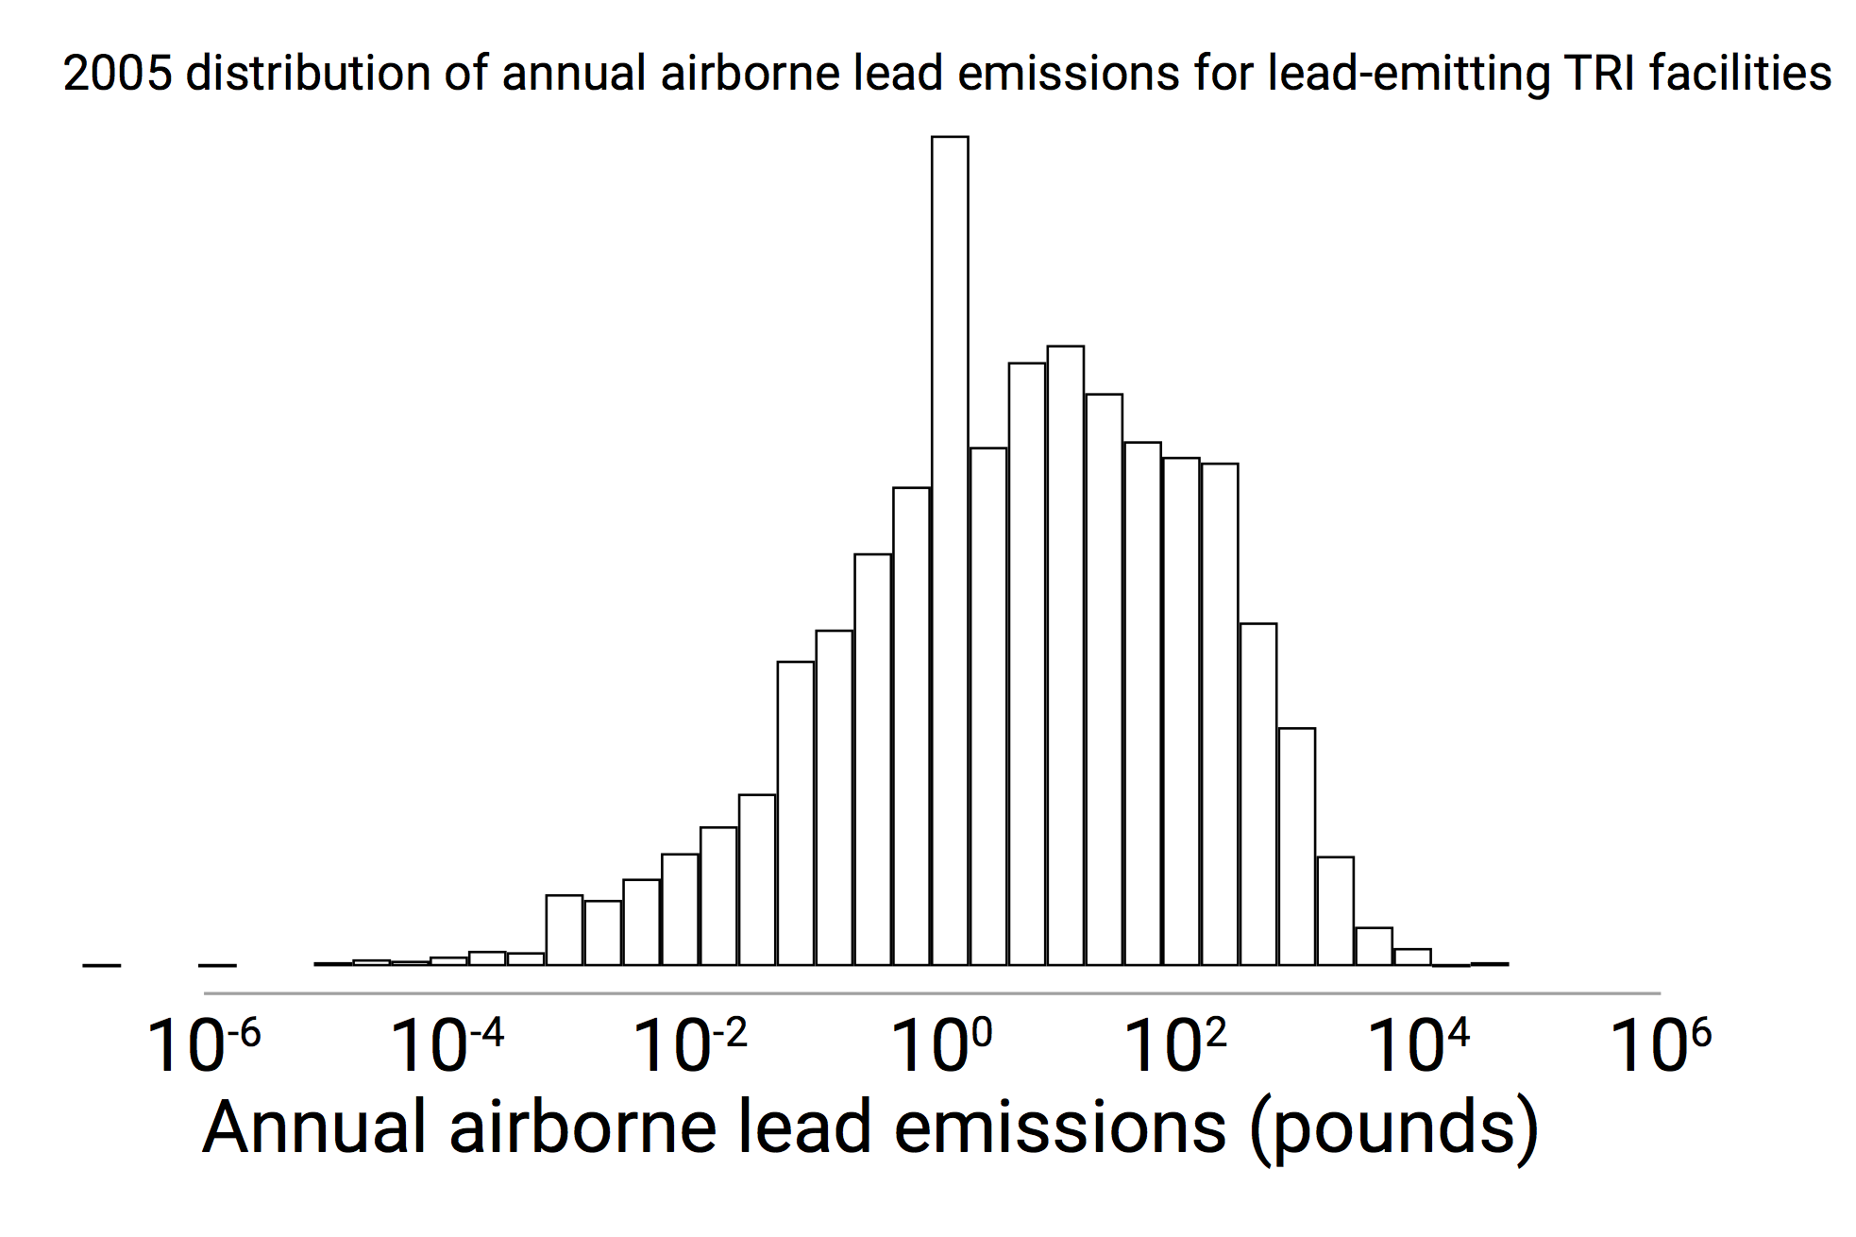

Slide 37
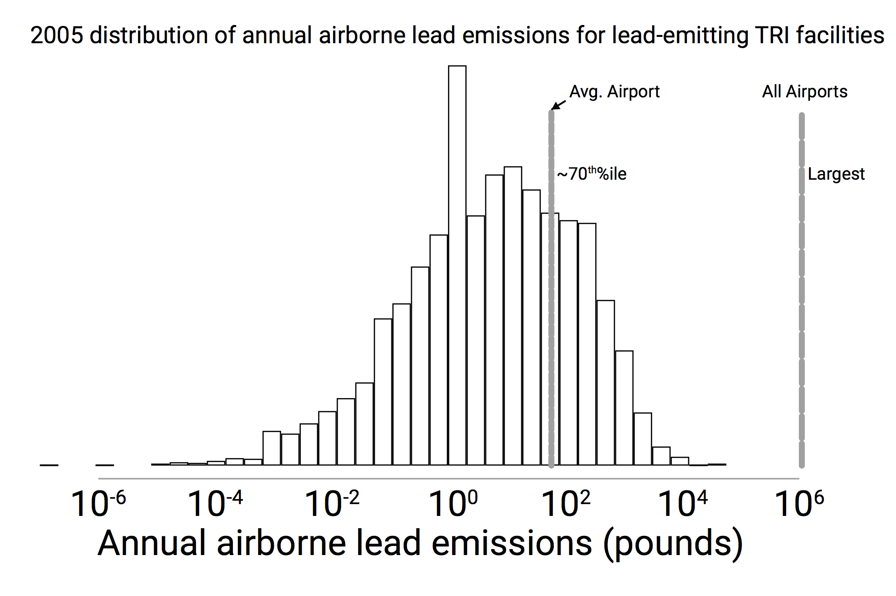

Slide 38
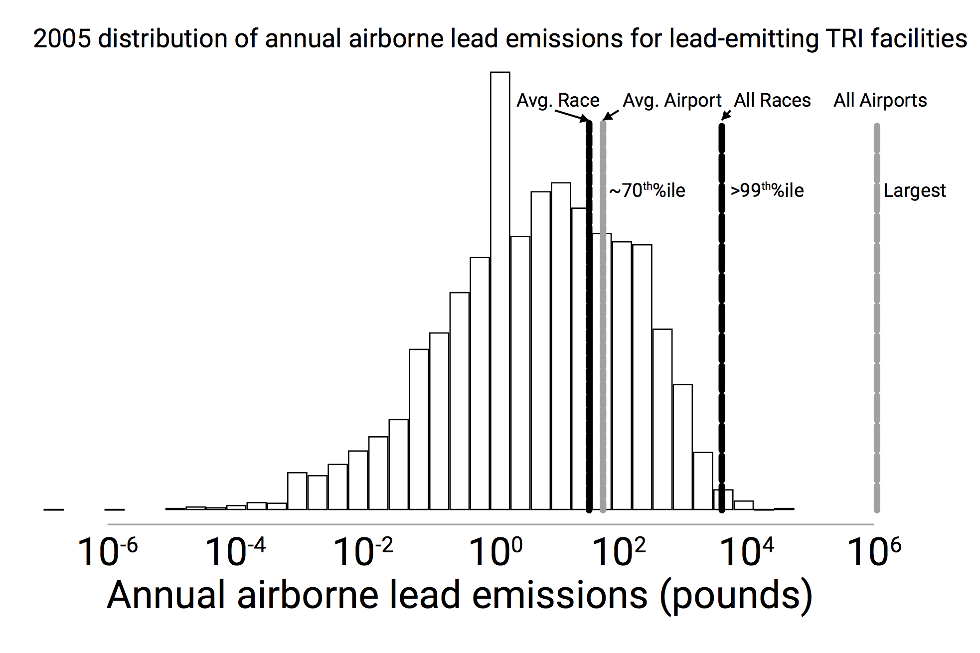
3 hour race vs annual totals!

Slide 39
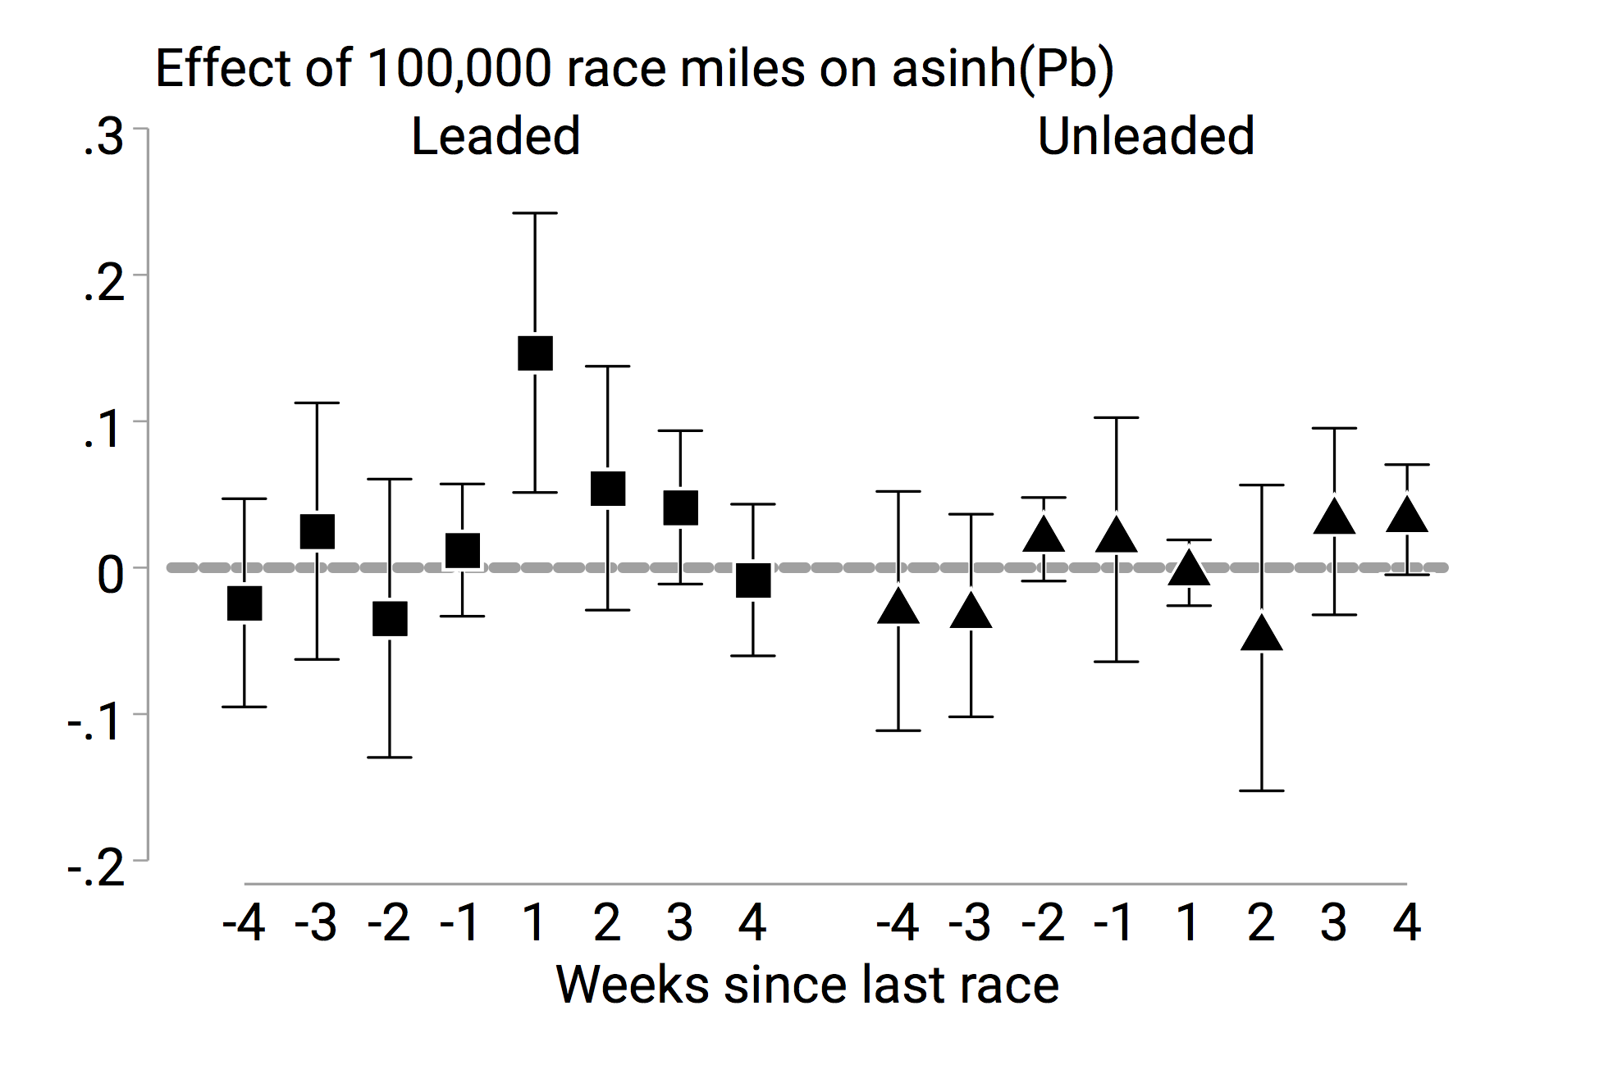

16% increase which
decays back to baseline

Slide 40
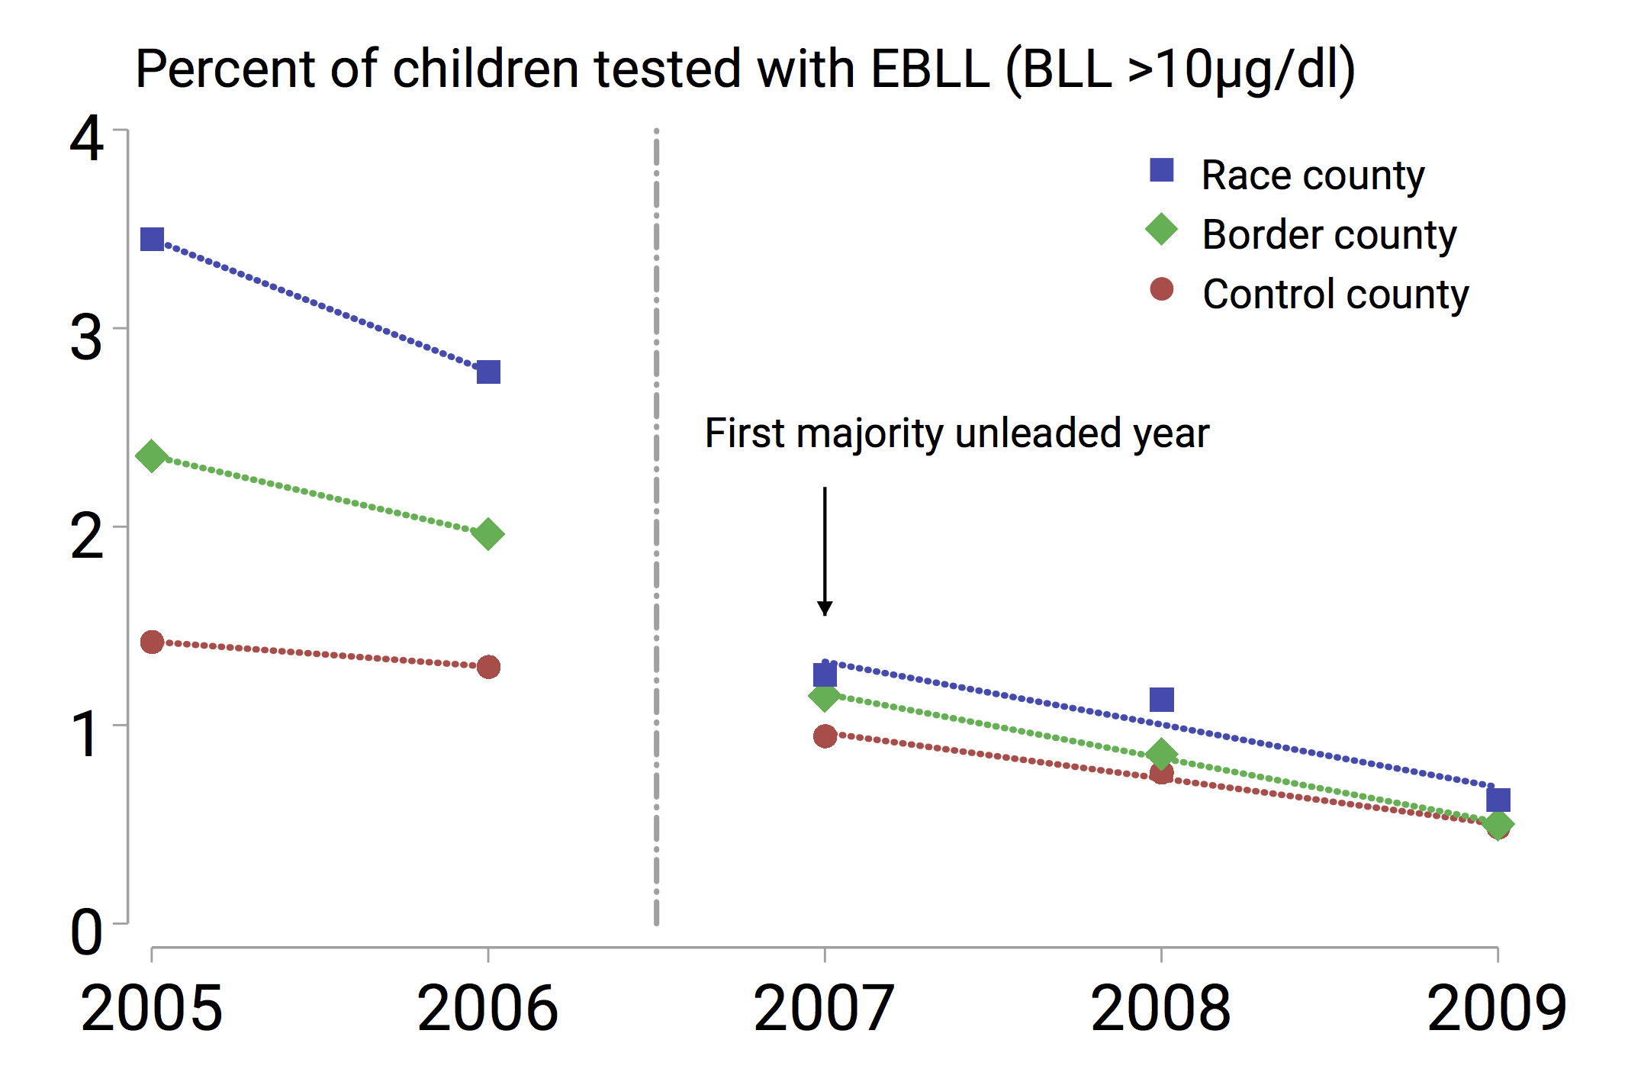

Slide 44
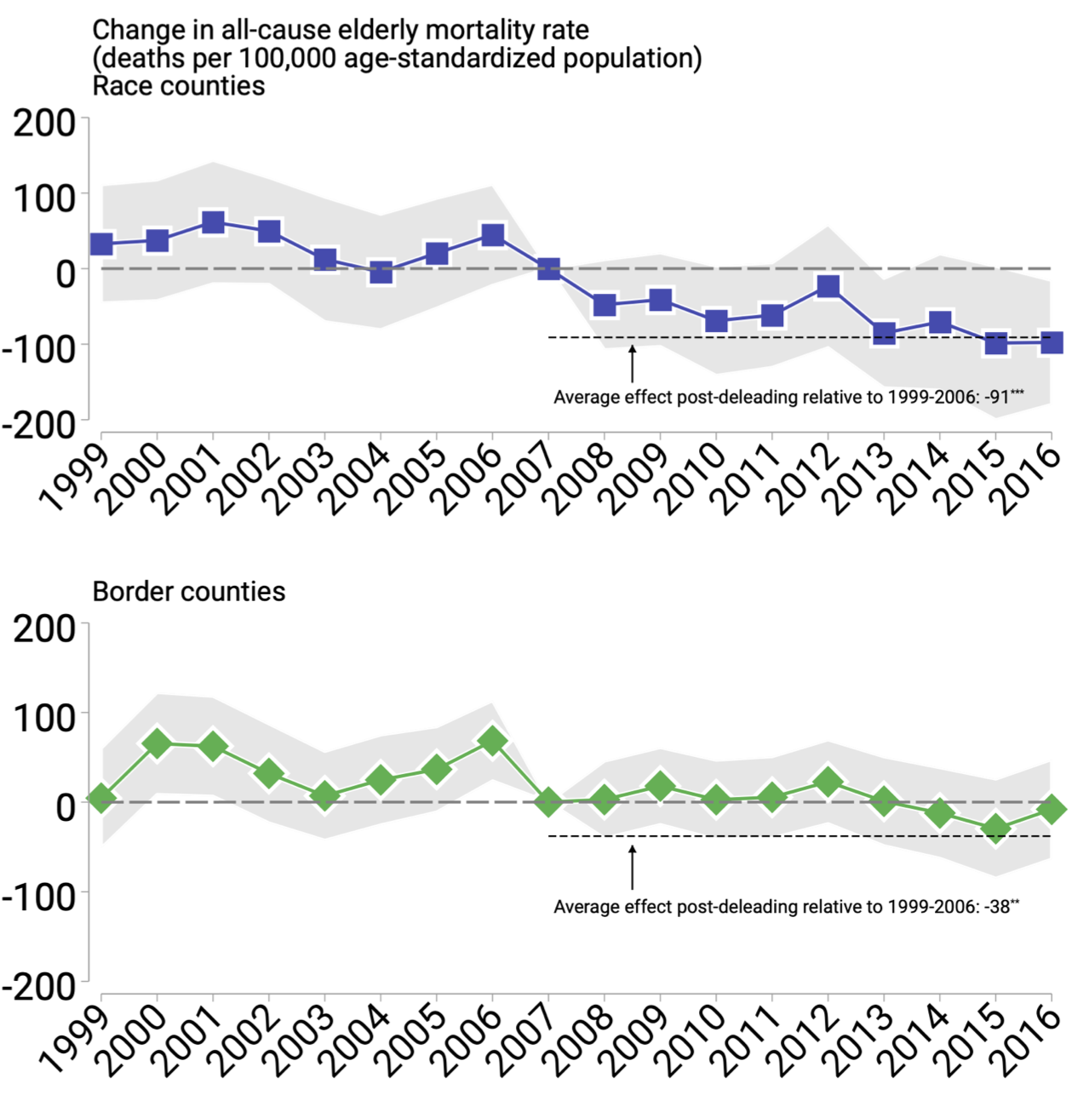
All-cause mortality
Picks up all effects
Circumvents issues with classifying cause of death
Gives a social cost of > $1,000 per gram of lead

Slide 45
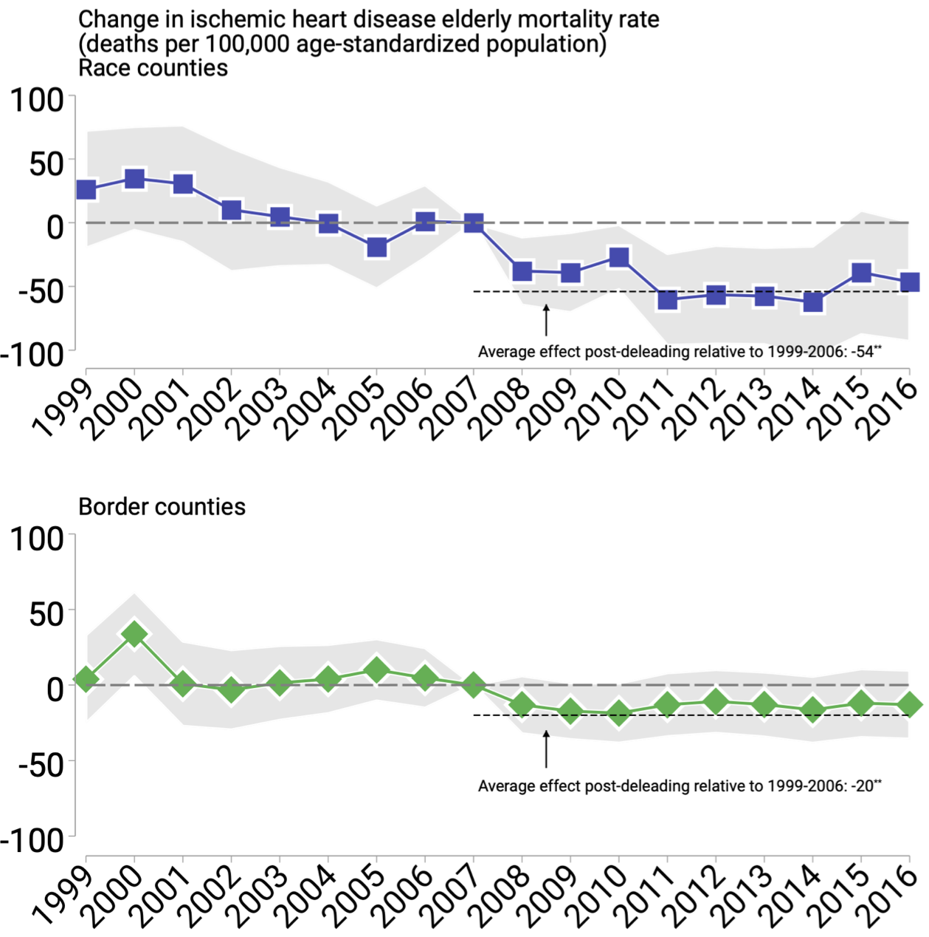
Ischemic heart disease
Blood vessel diseases, typically caused by plaque build up
Common cause of death in associational findings

Slide 46
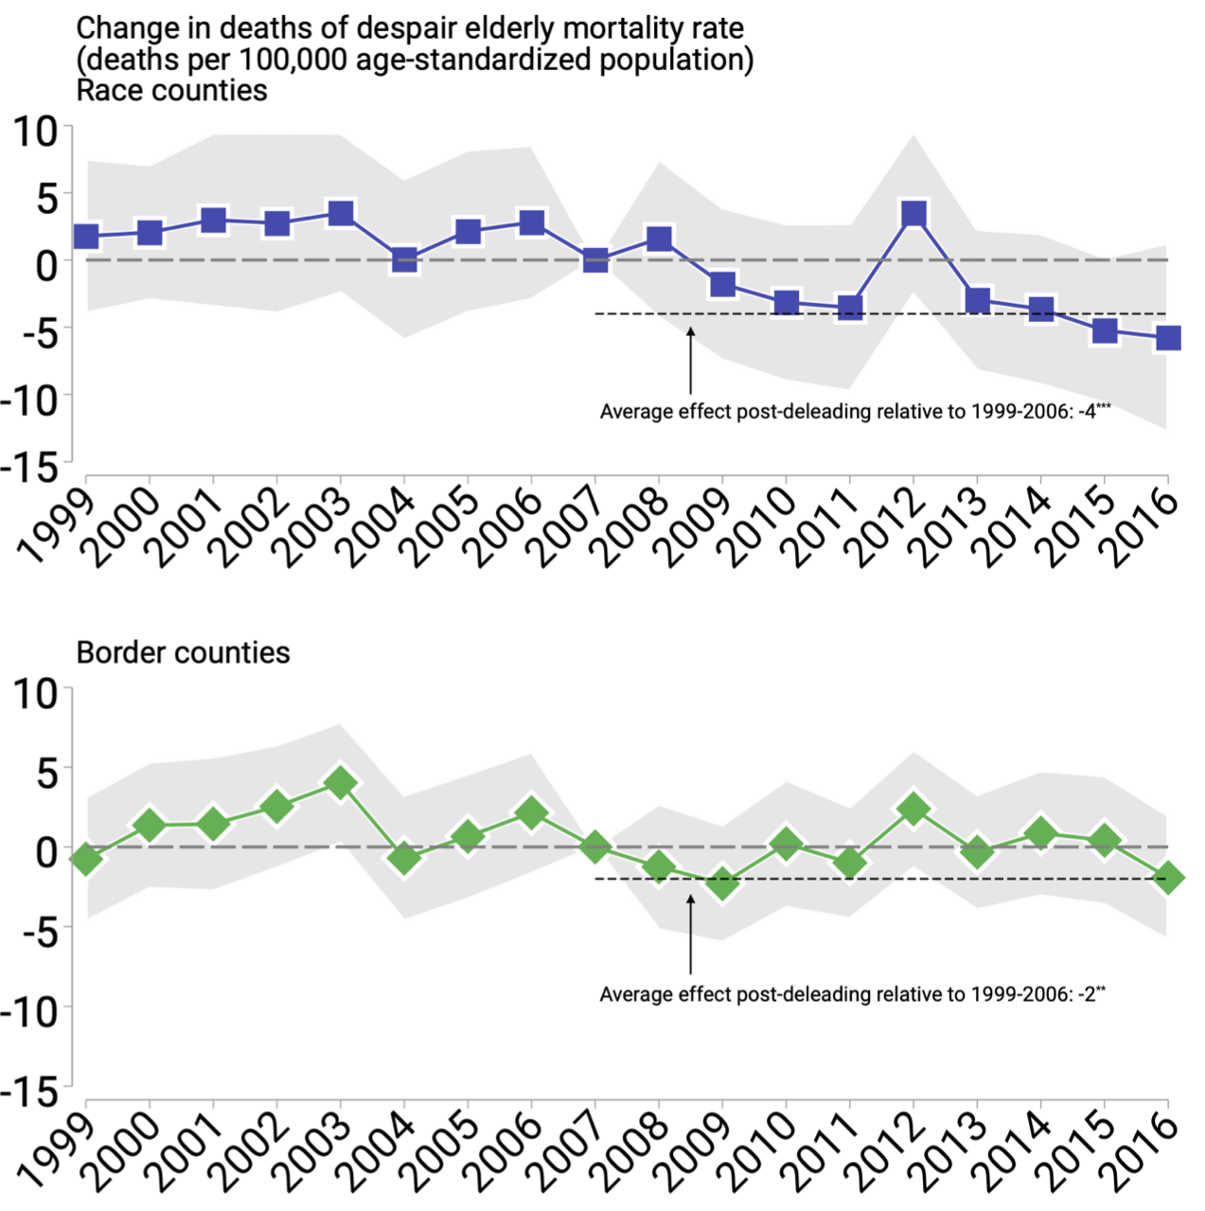
MAYBE affects deaths of despair (Case and Deaton)
Lead has significant negative effects on mental state, emotional stability, cognition

Slide 47
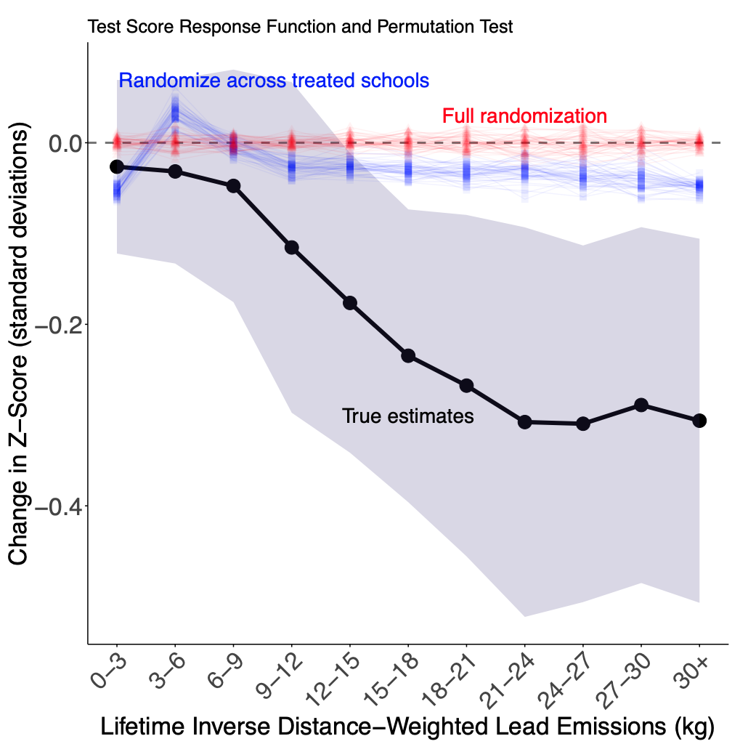
Lead is bad for test scores

Slide 48
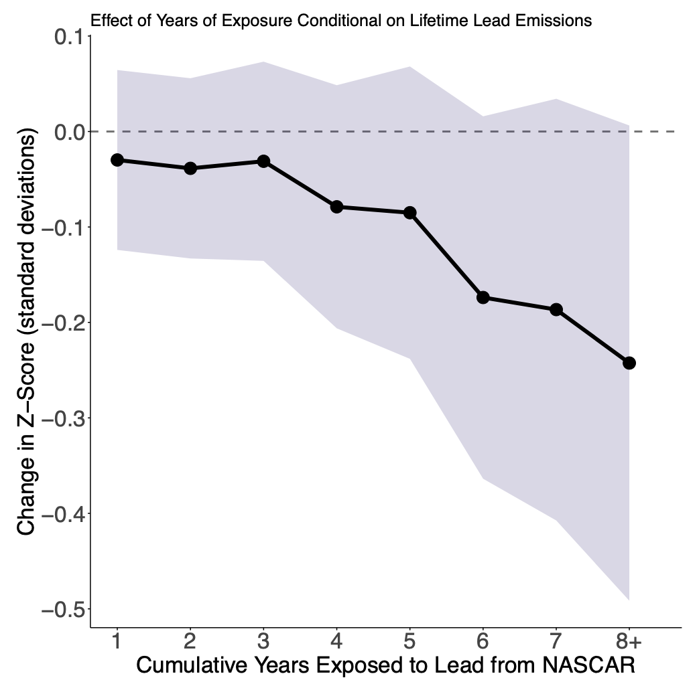
The same exposure spread out over time is even worse

Slide 49
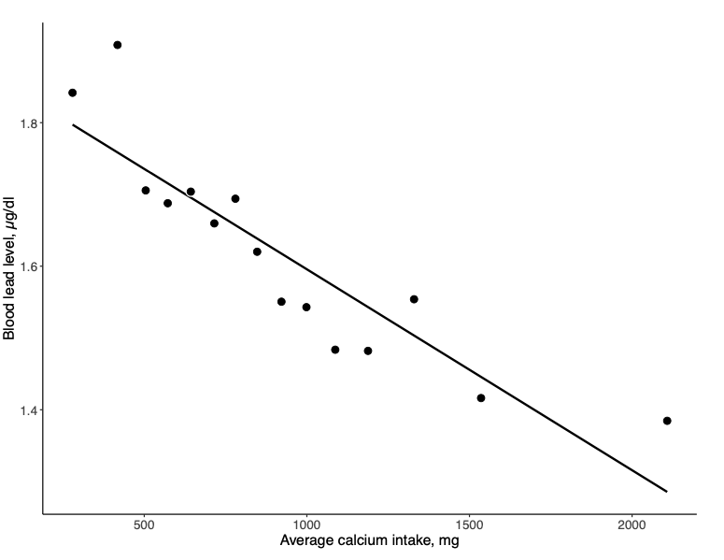
Raw correlations suggest calcium can mitigate lead exposure

Slide 50
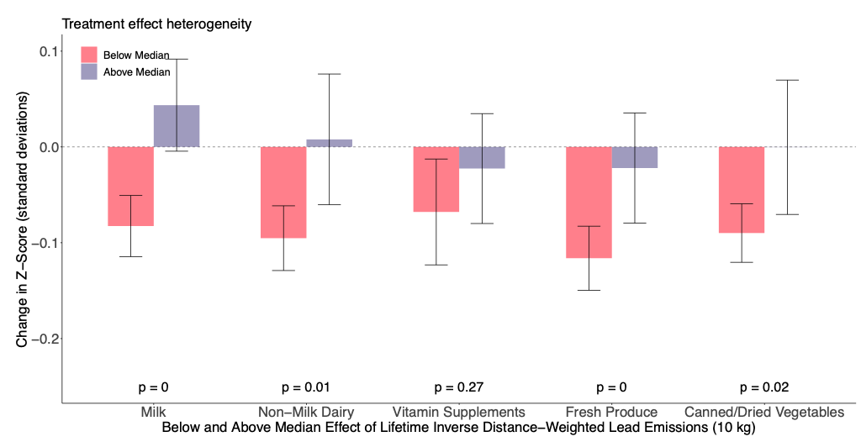
Nutrition matters

Slide 51
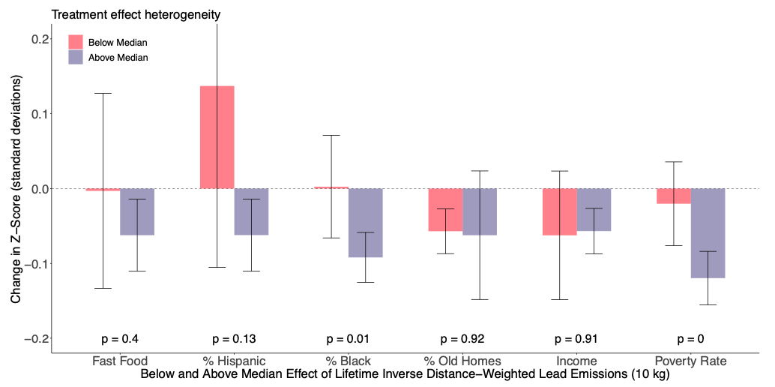
NASCAR lead was socioeconomically regressive

Slide 52
Biodiversity
What are the economic determinants of biodiversity?
Ozone (Liang et al. 2020)
General economic production (Liang, Rudik, Zou 2021)

Slide 53
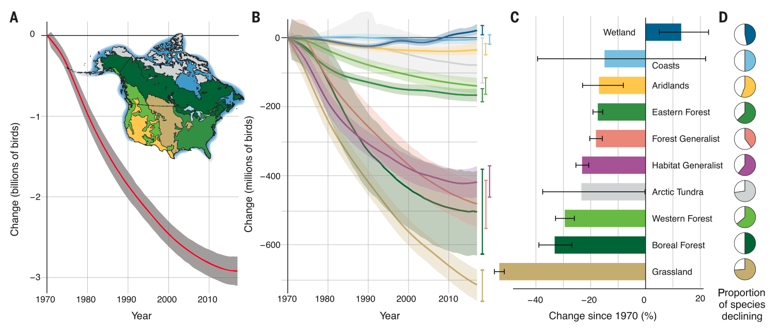
North American bird populations are falling
Rosenberg et al. (2019) [Lab of O]

Slide 54
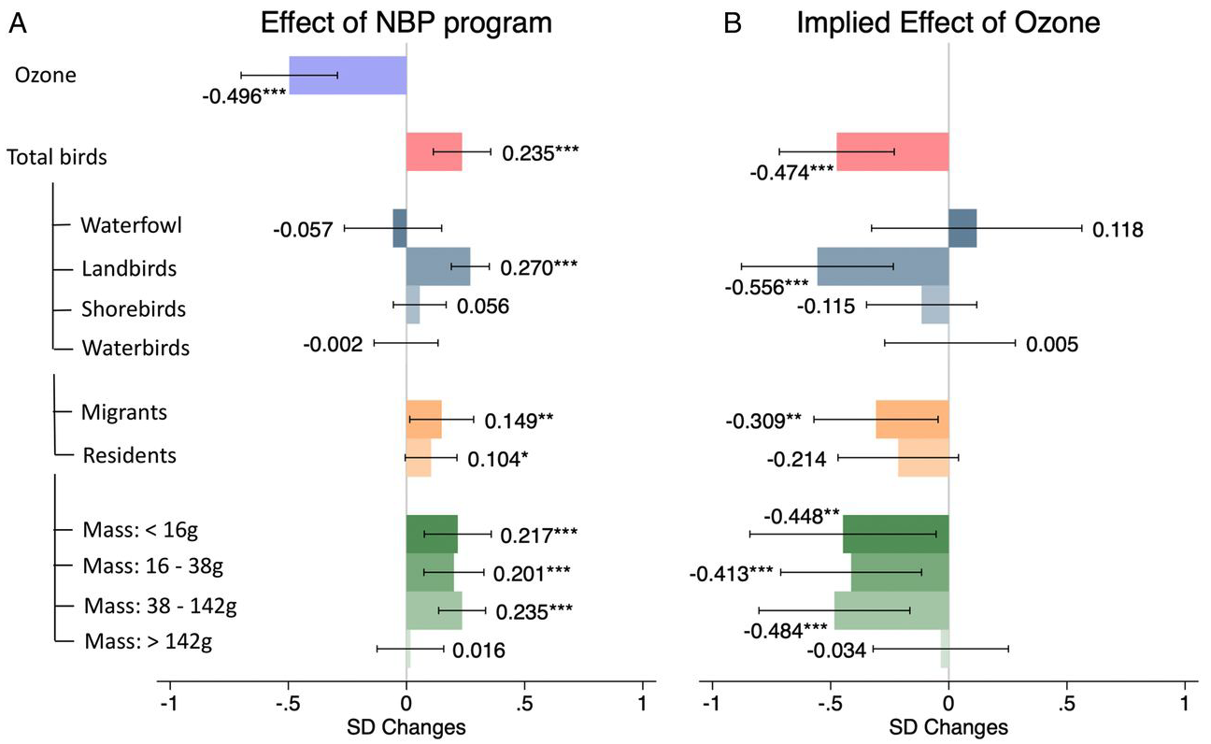
Ozone kills birds

Slide 55
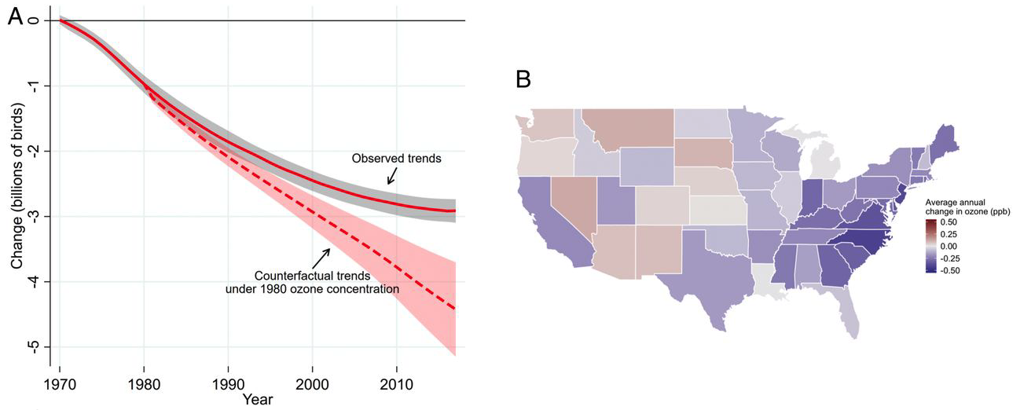
Ozone kills birds

Slide 56
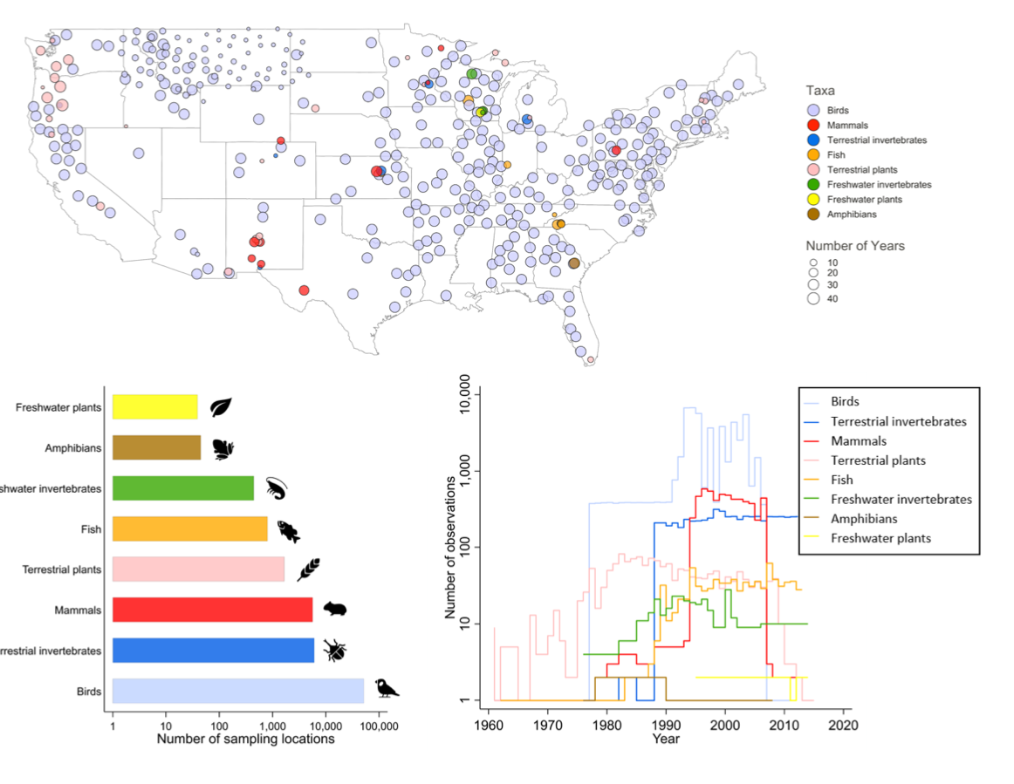
What about other species?

Slide 57
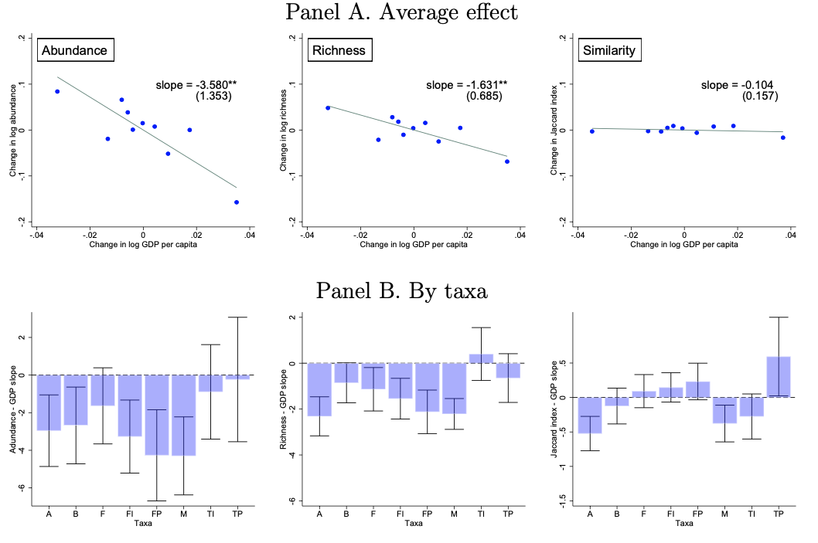
Development is bad for biodiversity

